Slide 1
Domain Driven Design
Tackling Complexity in the Heart of Software

Slide 2
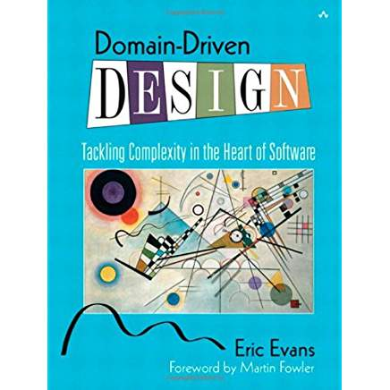

Slide 3
How Does DDD Apply Now?
Resurgent due to microservices.
The issues it addresses aren’t going away.

Slide 4
Complexity
What is complex about software?

Slide 5
“No Silver Bullet”
Accidental Complexity
Essential Complexity
Notes:
Fred Brooks 1986.
Also, Mythical Man Month. Shockingly applicable advice for stuff written 30 and 40 years ago.

Slide 6
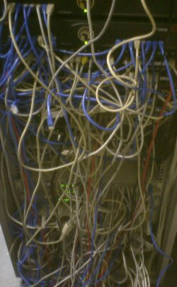
Accidental Complexity
Technology

Slide 7
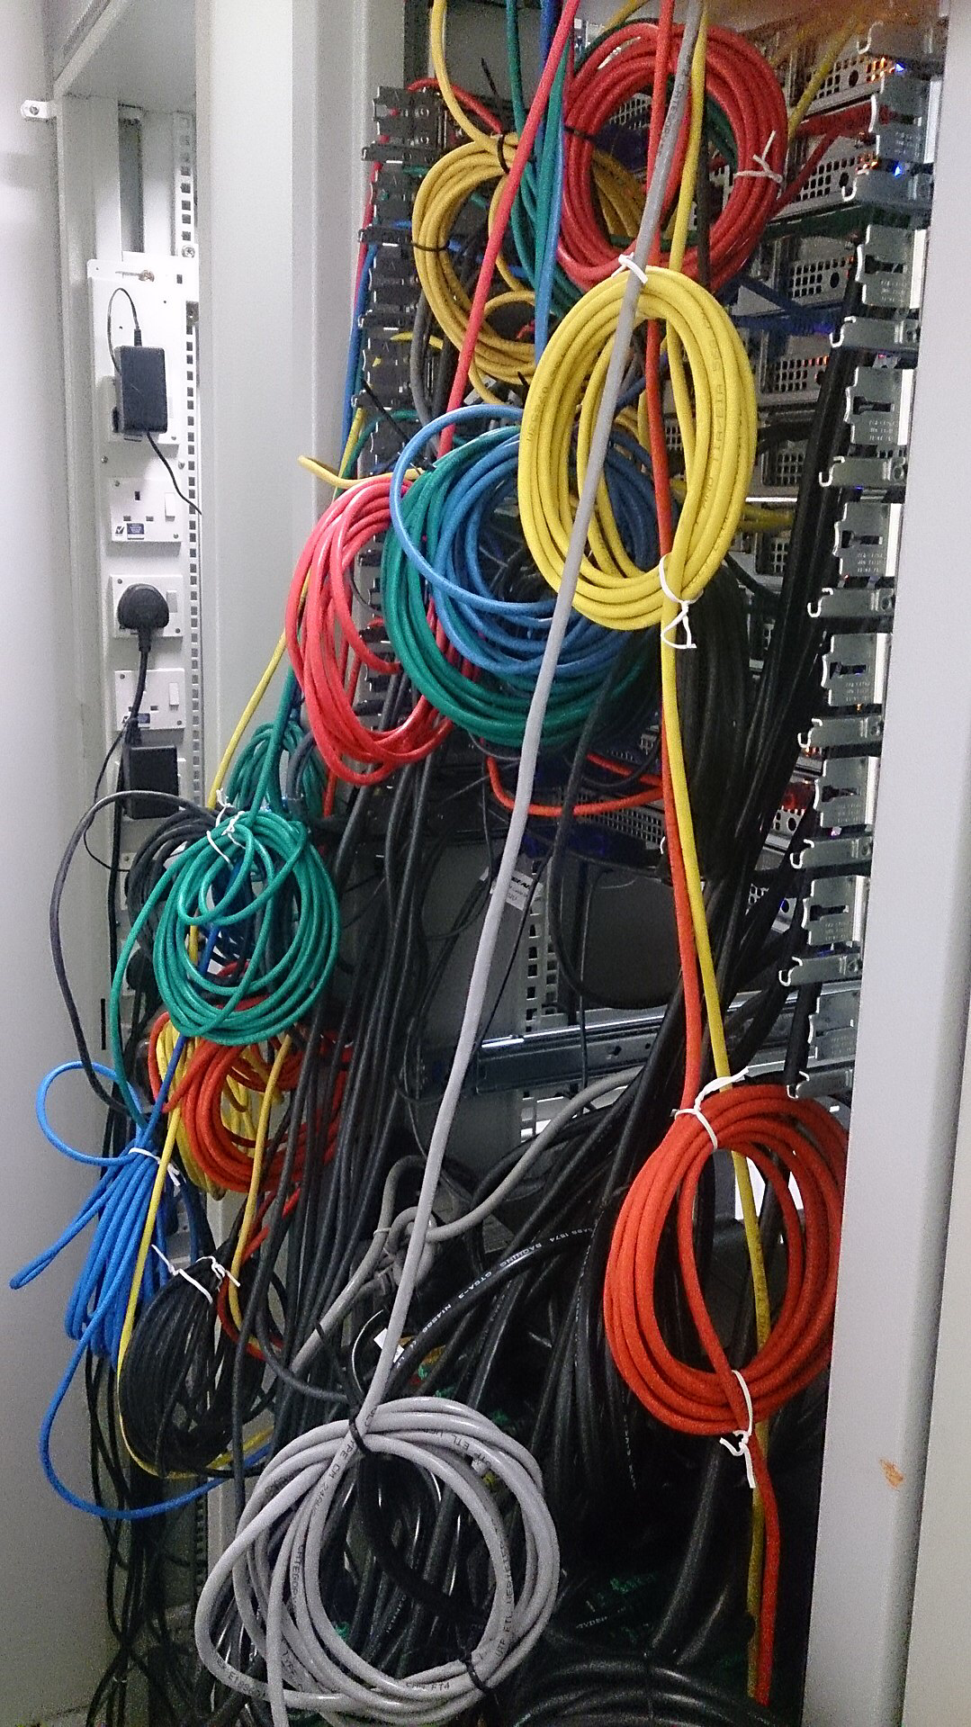
Essential Complexity
The business

Slide 8
Coupling
Compile Time
Run Time
Temporal
Semantic
Database transactions

Slide 9
Boundaries
Where should we have boundaries?
How should we create them?

Slide 10
Tackling Complexity in the Heart of Software

Slide 11
Most people know the tactical patterns
Repository
Entity
Value Object
Etc.

Slide 12
Strategic Design

Slide 13
Bounded Context
Terms have a specific semantic meaning in a context
A term may have a different meaning in a different context. Or none at all.
A bounded context provides a place for a set of terms to have meaning

Slide 14
Organization
On large systems, a bounded context should belong to a team
On smaller systems, multi module build
Different bounded contexts can have their own architecture

Slide 15
Bounded Context Nuance
Technology can be its own BC
REST
Database
Different representations of the same thing
Customer in 2 different lines of business

Slide 16
Ubiquitous Language
Shared language between developers and business
Code named in ways the business understands
Should be working with a domain expert or proxy

Slide 17
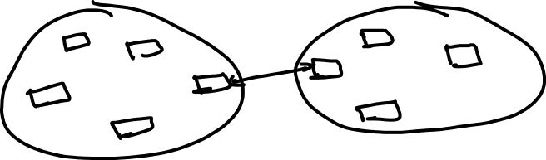
Context Mapping
Mapping concepts between different bounded contexts

Slide 18
Mapping Patterns
Coupling
Direction
Power/Influence

Slide 19

Shared Kernel
Bounded contexts share a portion
Requires coordination

Slide 20
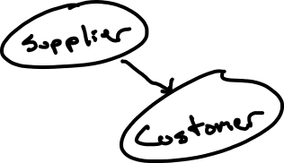
Costumer-Supplier
Customer has influence to set requirements
Supplier tries to support them

Slide 21



Conformist
Like Customer-Supplier, but…
No influence over Supplier
Example: Using 3rd party services

Slide 22
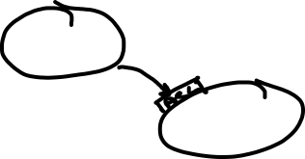


Anti Corruption Layer
Protects a bounded context from others
Can be significant effort

Slide 23
Anthropomorphism
I think in terms of contexts knowing about each other
Should shipping know about payments?
Should shipping have deep knowledge of payments?

Slide 24
Java Boundaries
Source Code Repository
Modules
Packages
Access Modifiers
Jars in Java 9

Slide 25
For a sufficiently large system, not all of it will be well designed.

Slide 26
Domain
Some slice of your software
Ideally, maps to a bounded context
Also, subdomains

Slide 27
Domains
Generic
Supporting
Core

Slide 28
How do I know?
 | Same | Unique
Not Differentiating | Generic | Supporting
Differentiating | Huh? | Core
Notes:
Money = Rare + Valuable

Slide 29
What Should I Do?
Generic
“Buy”
Use 3rd party
Use a framework
Supporting
Develop, maybe outsource
Core
Develop
Focus efforts here

Slide 30
Determining a Core Domain
Your shipping company differentiates itself by the fastest delivery.
What’s your core domain?
Routing?

Slide 31
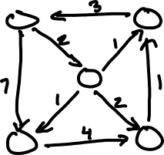
Fine Grained
Routing has parts
Directed graph of routes
Costs (in time) on connections
Algorithm for selecting lowest cost route

Slide 32
Core Domains Can Change
When the business changes, which domains are core may, too.

Slide 33
Tactical Design
A layered, object-oriented approach based on the DDD principles.

Slide 34
Modeling
“All models are wrong. Some models are useful”
Evaluate the ideas in the context of the model

Slide 35
Domain Classes
Classes that holds the business logic

Slide 36
Entity
Object with a persistent identity in our model
Mutable

Slide 37
Value Object
No identity outside the entity
Immutable

Slide 38
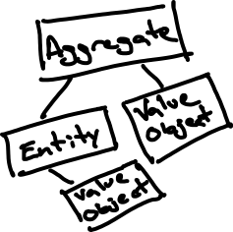
Aggregate
Entity responsible for maintaining internal consistency
Operations must be performed on the aggregate
Like adding a line item to an order

Slide 39
Domain Service
Stateless location for business logic that doesn’t belong in any one entity
Banking transaction

Slide 40
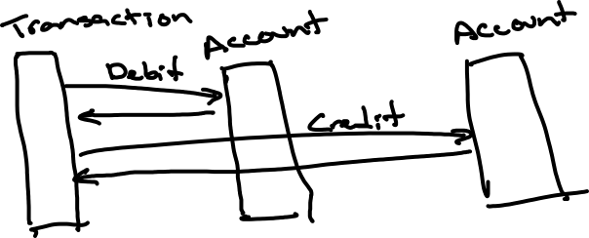

Slide 41
Domain Event
An event from your domain
Past tense (like OrderPaid)
Provides a nice solution in some circumstances
Or a whole architecture like CQRS

Slide 42
Repository
Allows us to treat objects like they’re a collection in memory

Slide 43
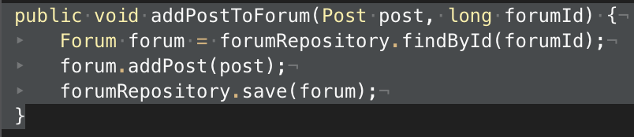
Application Service
Coordinates domain logic and persistence

Slide 44
Flavors of DDD
Original (Object-oriented)
CQRS (Event oriented)
SOA Udi Dahan (Event oriented)
Vlingo (Actor model)

Slide 45
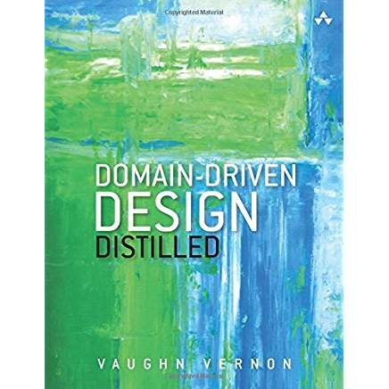
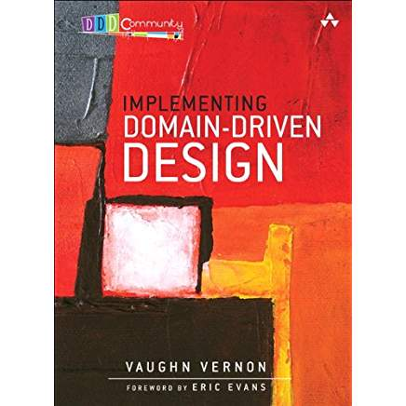
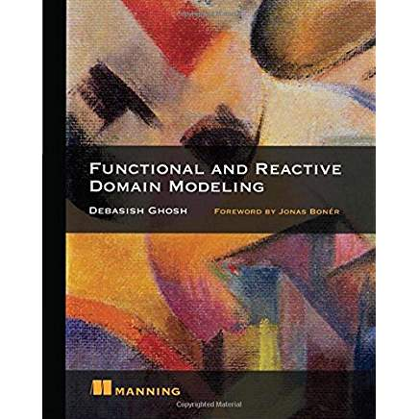
Books

Slide 46
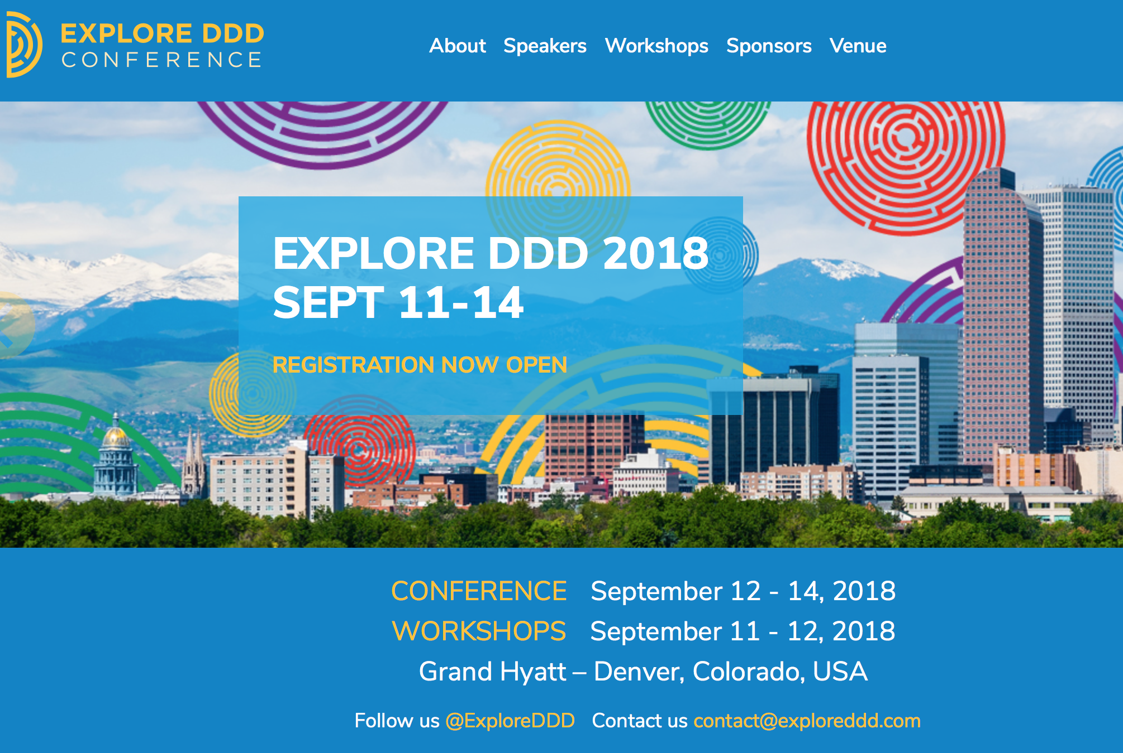

Slide 47
Contact Me
Sethkraut@gmail.com

